Slide 2
PROBLEM SOLVING WITH DATA STRUCTURES AND ALGORITHMS
Takayuki and Gil

Slide 3
How can we get all occurrences of a word from a given text?
Knuth–Morris–Pratt (KMP) algorithm

Slide 4
TEXT
k | o | r | o | k | o | k | o | k | o | r | o | k | o | r | o | k | y | k | o | r | o | k | o
PATTERN
o | r | o | k | y | k | o | r | o | k | o

Slide 5
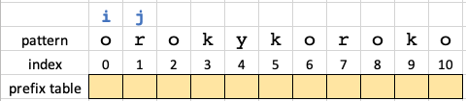
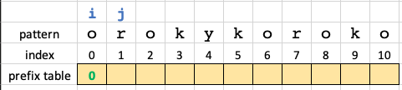
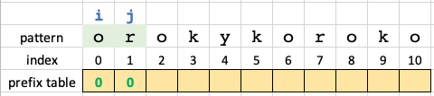
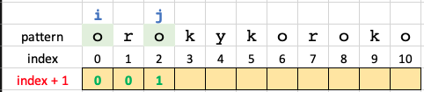
Building the Prefix Table

Slide 6
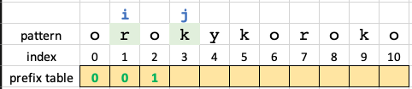
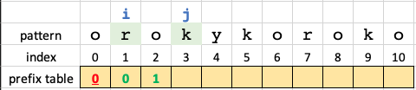
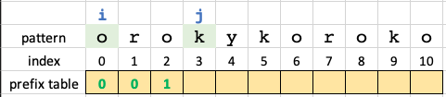
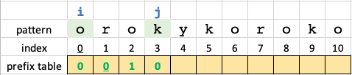

Slide 7
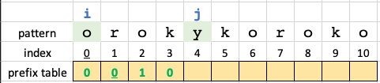
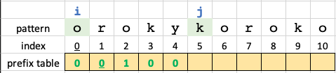
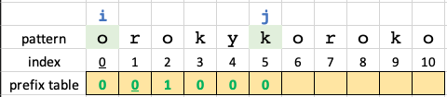
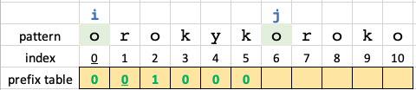

Slide 8
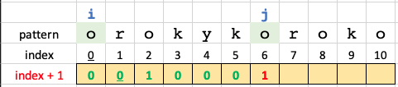
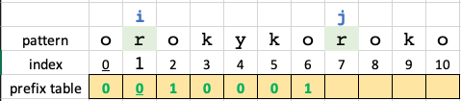
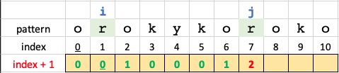
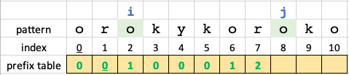

Slide 9
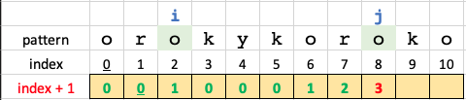
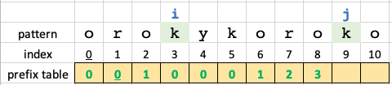
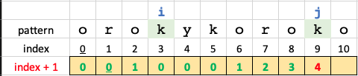
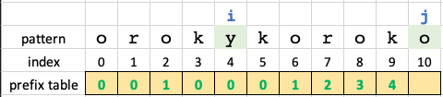

Slide 10
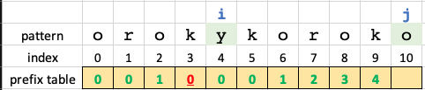
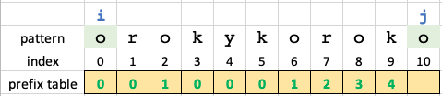
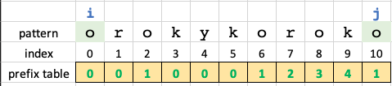

Slide 11
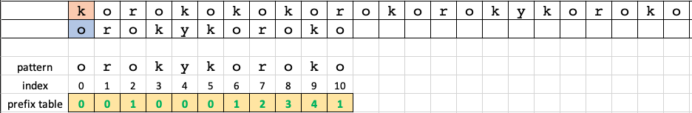
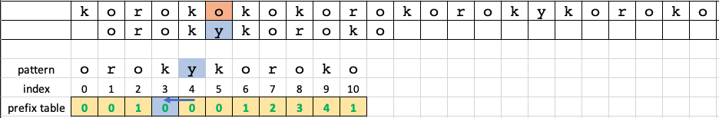
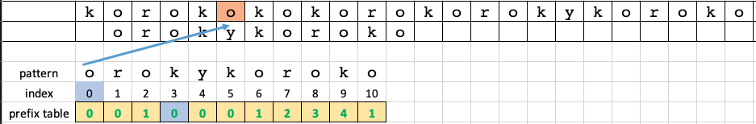
Matching the pattern to the text

Slide 12
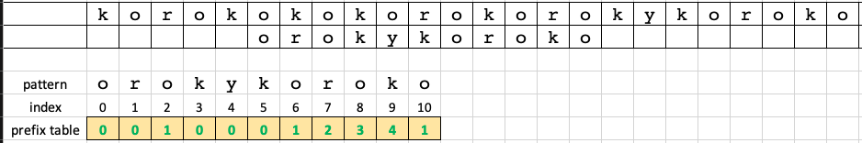
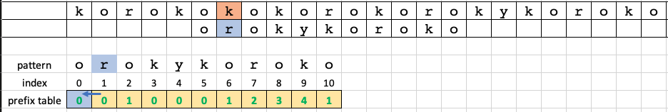
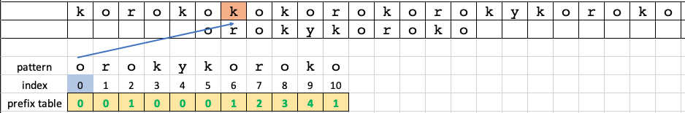

Slide 13
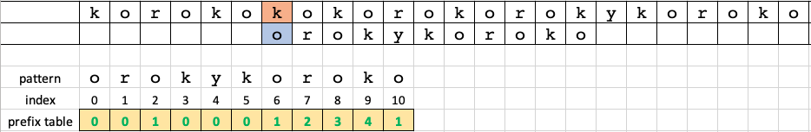
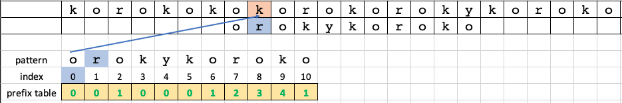
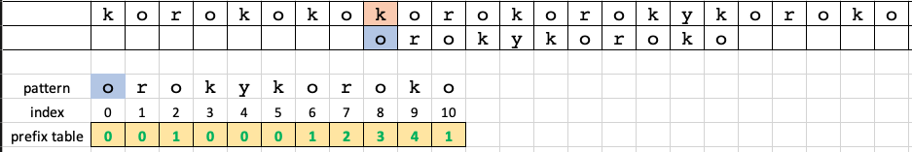

Slide 14
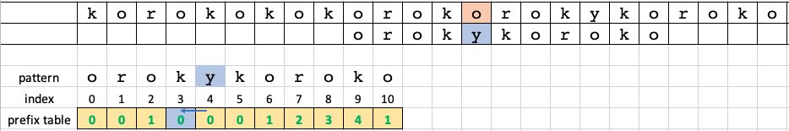
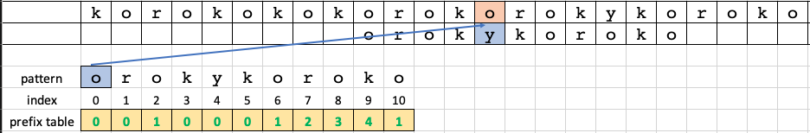
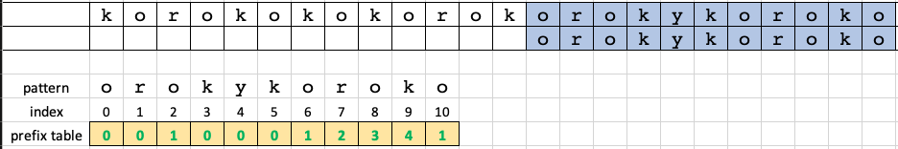

Slide 15
Rabin-Karp algorithm

Slide 16

Rabin-Karp algorithm
Using hash to check for a match
Unique but easy to recalculate (rolling hash)
a a a a a c a
a a a a a c a
Hash: 9812
a a a a b
a a a a b
Hash: 9732
M → O(M)
M → O(1)

Slide 17
Hash
Avoid collision as far as possible
Re-calculation must be O(1)

Slide 18

Avoid collision
a → 1
b → 2
c → 3
a a b → 1+1+2 = 4
a a c → 1+1+3 = 5
b a a → 2+1+1 = 4

Slide 19

Solution: Avoid collision
a → 1, b → 2, c → 3
1st + 2nd + … + nth
a a b → 1+1+2 = 4
a a c → 1+1+3 = 5
b a a → 2+1+1 = 4
1*100+1*10+2*1 = 112
1*100+1*10+3*1 = 113
2*100+1*10+1*1 = 211
1st*pow(10, n –1 ) + 2nd*pow(10, n -2) + … + nth*pow(10, 0)
digits

Slide 20
Recalculation must be O(1)
a a a a a c a
a*10^4 + a*10^3 + a*10^2 + a*10^1 + a*10^0 = 11111
a a a a a c a
a*10^4 + a*10^3 + a*10^2 + a*10^1 + c*10^0 = 11113
M letters for pattern → O(M) for calculating hash

Slide 21
Solution: Recalculation must be O(1)
a a a a a c a
a a a a a
1 1 1 1 1
a*10^4 + a*10^3 + a*10^2 + a*10^1 + a*10^0 = 11111
Subtract top digit
a a a a
1 1 1 1
Shift (multiply 10)
a a a a a c a
a a a a
1 1 1 1 0
( 11111 - a*10^4 ) * 10 + c*10^0
Add new digit
a a a a c
1 1 1 1 0 + 3
( pre - top digit ) * 10 + new digit
O(1) for re-calculating hash

Slide 22
Hash
Avoid collision as far as possible
--> use as digit
Recalculation must be O(1)
--> (previous hash) + subtract, shift, add

Slide 23
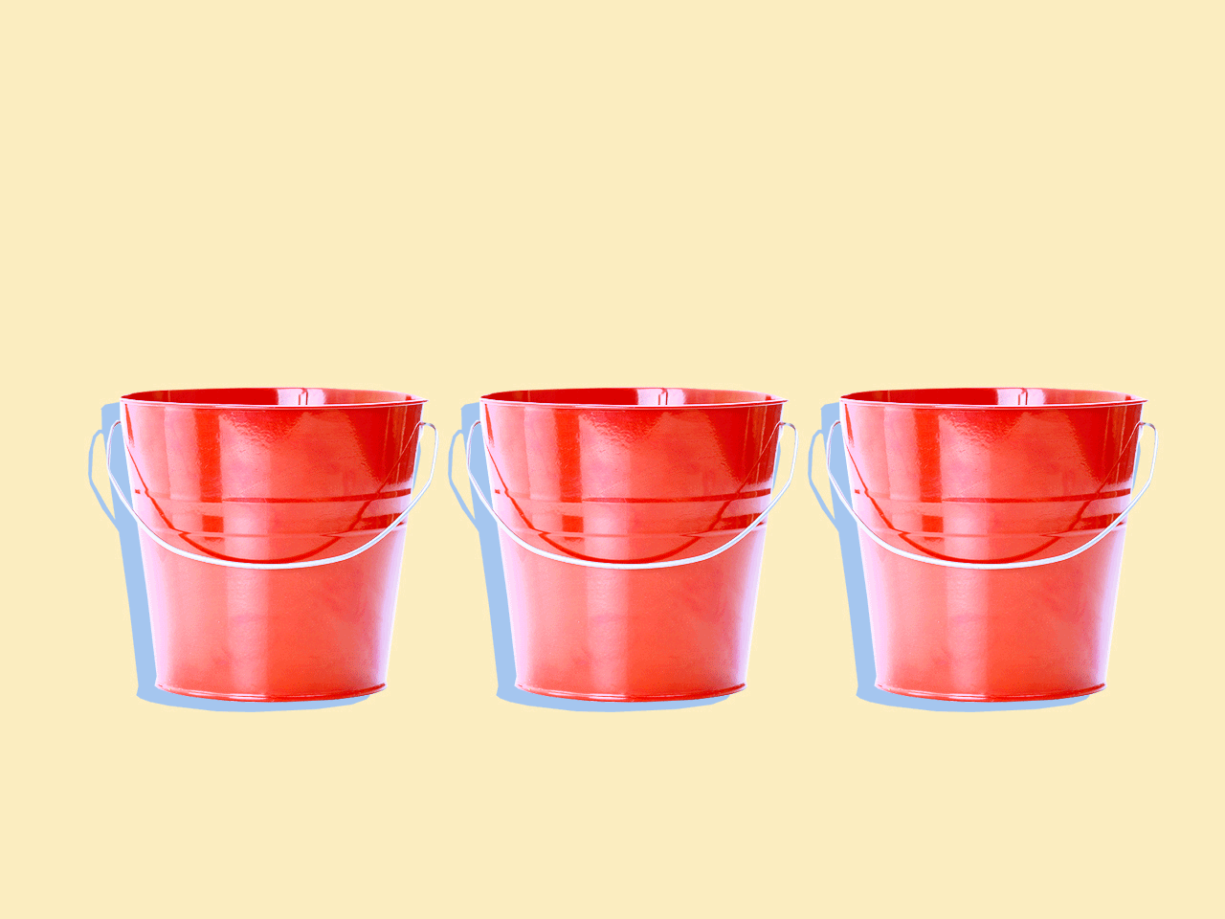
Real Case
Use 26 or number of character sets, instead of 10
If you use 10 as base, "aa" and "k" is same
Use modulus operator (remainder) to calculate the hash value
a*pow(26, n-1) + b*pow(26, n-2) + …
%(prime number) is used
194729412097987 % 113 -> it will allocate in 0..112
The smaller the divisor the lesser space consumption there is but higher probability of collision
The larger the divisor the larger space consumption there is but lower probability of collision

Slide 24
Create hash of text, pattern
O(m)
For (search all window in text)
+
WindowHash = calcHash(window)
If hashOfPattern == windowHash:
If IsSameWord(pattern, window) return true
O(n –m +1)
calcHash(window)
Return (preHash – firstChar*pow(d, m)) - lastChar
O(1)
IsSameWord(pattern, window)
For i in range(m):
If pattern[i] != window[i]
Return false
Return true
O(m)

Slide 25
Complexity
Time
Worst O((n – m )*m)
Best O(n)
Space
O(1)

Slide 26
Let's create our own algorithm !

Slide 27
How about using dictionary instead of hash
a a a a a c a
11111 →
a: 5
a a a a b
11112 →
a: 4, b: 1

Slide 28
Keeping a dictionary of differences
How about using dictionary instead of hash
Diff dict
a a a a a c a c a
a: 1, b: -1
a a a a b

Slide 29
Keeping a dictionary of differences
Diff dict
a: -1 , c: +1
a a a a a c a c a
a: 1 , b: -1
a a a a b
a: 0 , b: -1, c: 1
b: -1, c: 1

Slide 30
Dictionary rule
Update value (+, -) and if key does not exist, add key with value 1. O(1)
When value becomes 0 → remove the key O(1)
When dictionary isEmpty → same frequency → Validate further
Diff dictionary
a a a a a b a c a
a a a a b
Validate further

Slide 31
Worst Case: O (m)
a a a b a a a a a a a
a a a a b

Slide 32
Time complexity
Initial creation of hash: O(m)
Iteration and checking: O(n - m)
Updating keys (dictionary): O(1)
Checking for an actual match: O(m)
O(m) + O(n - m) * ( O(1) or O(1) + O(m) )
-> best O(n - m) , worst O((n – m )*m)

Slide 33
Space complexity
O(1)
Diff { a:213, b: -112, …............. z: 8939 }
Diff { } → number of character sets

Slide 34


Slide 35


Slide 36


Slide 37

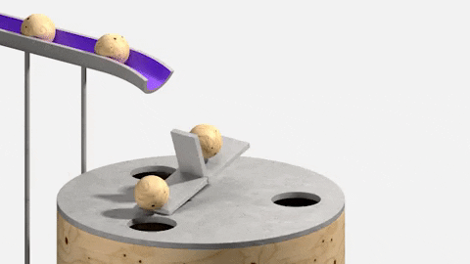


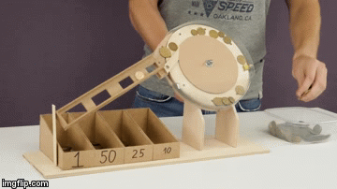

Slide 38
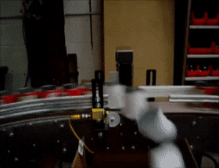

N items
M elements

Slide 39

Straightforward Solution
Scan each item in N and keep some of them as elements of M

Slide 40



Then when a new item is fed into N…
Remove an element from M if the condition is met
Scan each element of M
Finally, insert the new item into M

Slide 41
Time Complexity
O(M*N)
Scanning each item in N → O(N)
for item in N {
}
Validate whether the new item from N is a valid M element or not by scanning M → O(M)
for element in M {
perform delete, shift the remaining items (index + 1,) and then insert the item
if itemIsAcceptable { delete() shift()
insert()
} }

Slide 42



Slide 43

Keep the M-est element at the top
Instead of scanning each M element

Slide 44
Linear scan with using an array
Using heap
Search O(1)
delete(swap) insert(swap)
O(lg M)
Search then delete, shift, insert
O(M)
Delete item
insert item
Say we want to keep largest M elements

Slide 45
Key Concept to Solving the Problem
- We only have to know the smallest or largest element.
* Compare it to the new element, and then decide whether or not insertion is necessary
- We do not need to know the order of the remaining elements
Data structure to solve the problem
Heap
If you want to keep the largest M elements → min heap
Smallest M elements → max heap

Slide 46
[ 7 , 5, 9, 10, , ,, , , , ....]
N streams
[8, 9, 3 ,4, 5]
heap
Largest 5 items
1. A new item (7) comes from N streams
2. Compare to the current smallest number in the largest 5 items == 3
3. if new item > smallest item , try to insert the new element.
4. delete top (smallest) item : O(1)
5. re-order : O(lg M)
6. insert new item : O(1) 7. Re-order : O(lg M)

Slide 47
Time Complexity
O(N*(ln M))
Scanning each item in N => O(N)
for item in N {
}
Validate whether the new item from N is a valid M element by updating existing M => O(ln M)
Compare "M-est in M element" vs "new item”
if new item can be stored in M {
Delete(M-est)
Insert(new item)
}

Slide 48


